Slide 1
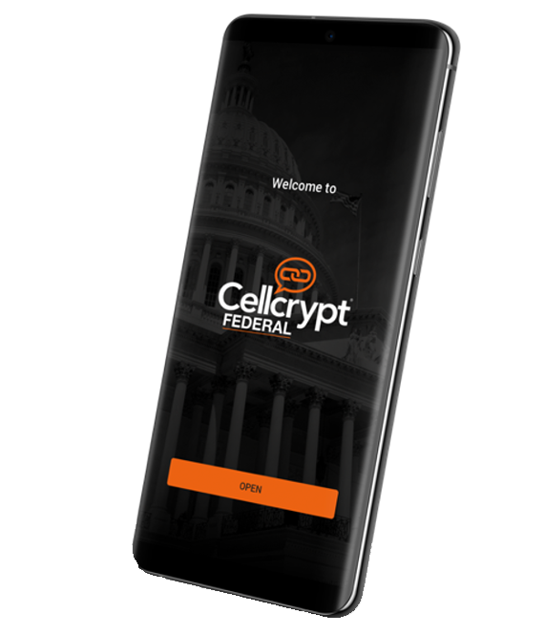
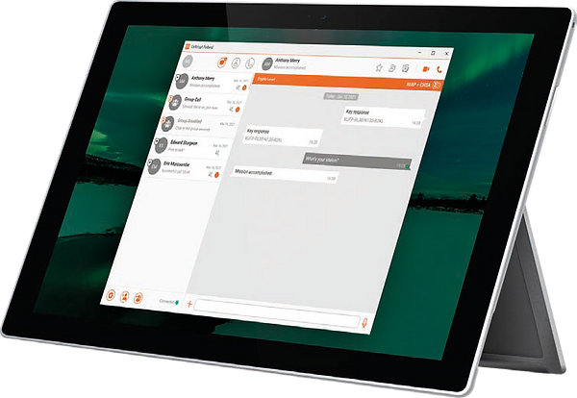
ZERO-TRUST
SECURE COMMUNICATIONS
& DATA-IN-TRANSIT
Notes:
Cellcrypt Federal - Secure Communications in a Zero Trust World

Slide 2
Trust in a Zero-Trust World
Full Assurance for Communications and Data-in-Transit
Even in austere, ‘Zero-Trust’ environments that have been proactively compromised
Notes:
Network Infrastructure should be assumed to be compromised.
Cellcrypt negates that risk.

Slide 3
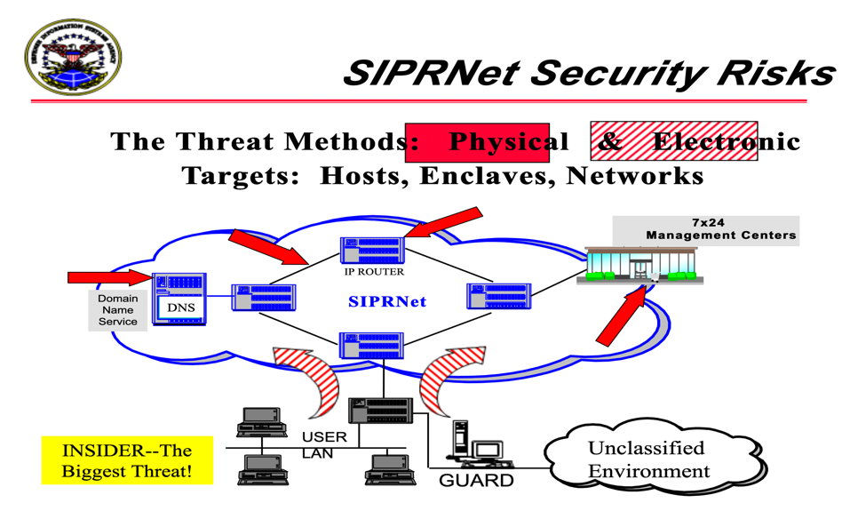
Walled Garden
Reliance on a “Trusted” Network
Many solutions rely on ‘trust’ in a “Walled Garden” i.e., companies that provide the solution, individuals that run the system and security of the network
Walled Gardens are vulnerable to a number of threats and do not tackle the greatest problem – the INSIDER – the biggest threat as acknowledged by DISA
Notes:
Governments often trust their networks, despite advocating Zero Trust.
These trusted networks have consistently failed to provide the protection needed.
The insider threat is often the biggest risk.

Slide 4
Harvest Now, Decrypt Later The Quantum Computing Threat
Although quantum computers powerful enough to break the strongest classical encryption do not exist yet, retrospective decryption is a real threat
Information and communications encrypted with current cryptographic techniques can be intercepted, stored and later decrypted once more powerful quantum computers arrive
Critical data requiring long-term security should be protected now
Notes:
Broken networks allow bad actors to harvest data now, for decryption later.

Slide 5
Certified Encryption Tunnelled End-to-End
CNSA Encryption +
Post-Quantum Protection
TLS SIP / SRTP
(Cellcrypt negotiated in SDP)
TLS SIP / SRTP
(Cellcrypt negotiated in SDP)
Cellcrypt Federal tunnels end-to-end encryption through NIAP-approved tunnels
Cellcrypt Federal encryption tunnels through RTP for end-to-end CNSA+QSE voice encryption
Cellcrypt Federal protocol negotiated via Session Description Protocol (SDP)
E2E Encryption delivers robust communication security for every message, voice, and video call
Cellcrypt Server
Notes:
The Standards for Top Secret require a Trusted network.
But that same Standard is vulnerable at the server.
Cellcrypt negates the threat by tunnelling encrypted data, end to end.

Slide 6
Certified Encryption
A Multi-Layer Cryptographic Approach
CNSA Suite Guidelines | Cellcrypt
Advanced Encryption Standard (AES), per FIPS 197, using 256-bit keys to protect up to TOP SECRET. | AES-256 Fully Compliant
Elliptic Curve Diffie-Hellman (ECDH) Key Exchange, per FIPS SP 800-56A, using Curve P-384 to protect up to TOP SECRET. | Fully Compliant (also supports P-521)
Elliptic Curve Digital Signature Algorithm (ECDSA), per FIPS 186-4, using ECDSA-384 to protect up to TOP SECRET. | Fully compliant (also supports P-521)
Secure Hash Algorithm (SHA), per FIPS 180-4, using SHA-384 to protect up to TOP SECRET. | Fully compliant (also supports SHA-512)
Data is Obfuscated
Encrypted with CNSA Cryptography
With Post-Quantum Protection
Running through a NIAP Architecture
Notes:
Cellcrypt uses a multilayer cryptographic approach; obfuscating data, classical encryption, with quantum-proof protection, before streaming end to end, within the NIAP Standard.

Slide 7
Cellcrypt Federal
Authenticated, E2E Encrypted Messaging, Voice, Video
Messaging, voice/video, and large file transfers are fully-encrypted end-to-end (E2EE)
Mutual Authentication for all parties eliminates spoofing and eavesdropping (MiTM) risks
Secure groups for messaging, calling, and file sharing
Device (iOS, Android, Windows) agnostic with enhanced “Data at Rest” Protection
Advanced codes for HD quality and low bandwidth mode for any network, e.g., 5G, 4G/LTE, 3G/HSDPA, 2G/EDGE, Wi-Fi, satellite
Interoperability with 3rd Party NIAP devices and PBX desk phones
Notes:
Cellcrypt Federal provides secure voice, video, messaging and file transfers; for mobile, desktop and PBX phones; over networks, from Satellite and 2G EDGE, to 5G and Wifi.

Slide 8
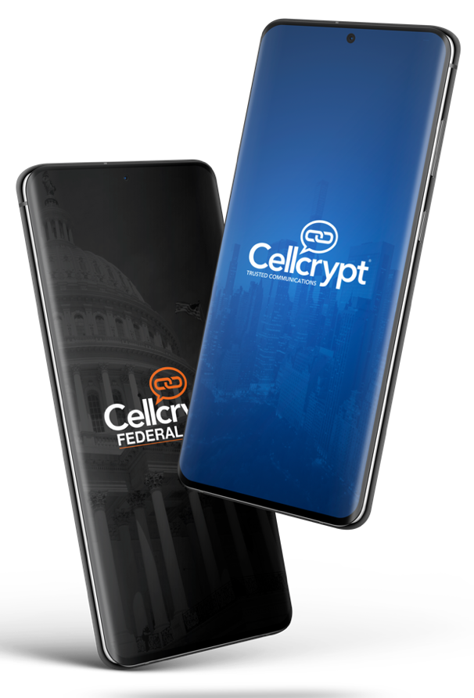
Cryptographically Surround the End-User
Cellcrypt allows you to segregate communications and run multiple branded apps simultaneously
For Government, this can segregate communications between Classified and Unclassified
Cellcrypt Federal (Orange App) – On-Premises or Tactically Deployed Classified (Red) Network
Cellcrypt (Blue App) – Cloud hosted Unclassified; Friends & Family; Welfare calling
Both apps are NIAP/CSfC and provide the same level of certified encryption
Offers a parallel redundant network with the same assurance of communications
Top Secret / SCI
Top Secret
Secret
Confidential
Unclassified
Notes:
Our solution can be on-premise or in the cloud.
Running multiple variants of Cellcrypt allows for user group segregation.

Slide 9
Cellcrypt Federal
Cellcrypt Federal offers a reliable and secure communication solution that meets the needs of Government Grade Security up to Classified Secret and Top Secret Communications
Full assurance for communications in even the toughest environments while offering a unique cryptographic approach that eliminates the need to trust and rely on the security of the Walled Garden
Notes:
Cellcrypt Federal provides Full Assurance in a Zero Trust world.

Slide 10
ZERO-TRUST
SECURE COMMUNICATIONS
& DATA-IN-TRANSIT
Notes:
Don’t accept Unnecessary Risk; Negate it; Trust Cellcrypt

